Slide 1
School of Computer Science Engineering and Information Systems
PAMCA698 — INTERNSHIP I / DISSERTATION I (PROJECT) | REVIEW 2 | FALL SEMESTER 2026–27 | 07.10.2026
Measurement-Process-Aware Causal Trajectory Modeling for Transportable Early Sepsis Prediction
Project: AegisSepsis AI — A Multi-Center Retrospective Evaluation
Sudhanshu Kumar Jha — 25MCA0181
Under the guidance of
Dr SWETA BHATTACHARYA
Associate Professor Grade 2

Slide 2
Presentation Outline
Abstract
Findings
Introduction
Novelty
Problem Statement
Methodology
Objectives
Requirements & Tech Stack
Scope of the Project
Results & Stress Tests
Proposed System
Testing, Policy & Project Plan
System Architecture
Summary & Future Scope
Literature Survey
2

Slide 3
Abstract
Sepsis causes nearly 20% of global deaths, and each hour of delayed treatment raises mortality by ~7.6%. ML early-warning models often collapse at new hospitals because they learn site-specific lab-ordering habits instead of true physiology.
AegisSepsis AI decouples physiological dynamics (causal Z-scores, velocity, acceleration) from observation-process vectors (masks, time deltas, sampling counts) and enforces mask-perturbation invariance: L_total = L_bce + λ·L_inv.
Evaluated without retraining on an independent 20,000-admission BIDMC cohort (0.00% overlap), it cut the transportability gap by 30.52% (p=0.001), was 2.93x more robust to 40% missing data, and a dual-tier policy suppressed 64.2% of false alerts with a 4.2 h lead time.
0.7310
external AUROC on BIDMC Set B (baseline 0.7161)
30.52%
reduction in cross-institution transportability gap
64.2%
false alerts suppressed; 4.2 h median lead time
Keywords: Sepsis Early Warning, Cross-Institution Transportability, Dataset Shift, ICU Observation Process, Missingness Modeling, Causal Trajectory Normalization.
3

Slide 4
Introduction
Scale of the Challenge
Observation-Process Shortcuts
Transportability Failure
Sepsis affects 49M+ people yearly and causes ~20% of global deaths; each hour of delayed antimicrobials raises mortality by ~7.6%.
ML models use lab-ordering frequency as a feature, learning site-specific habits that break at other hospitals.
Cross-institution AUROC decays by 0.05–0.12 (Nestor et al., 2019), blocking real-world deployment.
Alarm Fatigue
Project Approach
Unfiltered alerts overwhelm bedside staff; dual-tier screening is needed to cut false alarms.
AegisSepsis AI separates physiology (Z, dZ/dt, d²Z/dt²) from observation process (M, Δt, N) and enforces invariance to mask changes.
4

Slide 5
Problem Statement
Existing systems face critical challenges: ICU data is sparse and irregularly sampled, so imputation uncertainty becomes false alerts, and sepsis is only 7.57–12.4% of admissions, causing low sensitivity or high false-alarm rates.
Models also use lab-ordering frequency as a shortcut that holds at the derivation hospital but breaks where ordering is protocolized; AUROC decays by 0.05–0.12 across sites (Nestor et al., 2019). Black-box models further limit clinician trust.
☐
A system is needed that separates true physiological deterioration from clinical ordering behavior, stays robust at unseen hospitals, and explains every alert while limiting alarm fatigue.
5

Slide 6
Objectives
01
02
03
Causal Decoupling Framework
Causal Normalization
External Validation
Separate physiology (Z, dZ/dt, d²Z/dt²) from observation process (M, Δt, N).
Standardise 34 variables into causal Z-score trajectories without lookahead leakage.
Test on 20,000-patient BIDMC Set B with 0.00% overlap and zero retraining.
04
05
06
Stress Testing
Dual-Tier Alert Policy
Explainability & Deployment
Dropout 0–80%, same-physiology mask perturbation and density-quartile analysis.
Deploy VAL_POL_0450 to cut false bedside alarms by 64.2%.
TreeSHAP rationales and containerized FastAPI microservices for ICU decision support.
6

Slide 7
Scope of the Project
Data Scope
Cohort Isolation
System Role
Emory Set A (20,336 admissions; 2,974 locked test, 12.4% prevalence) and BIDMC Set B (20,000; 7.57%); 34 variables: 8 vitals + 26 labs.
Strictly 0.00% patient overlap verified by SHA-256 audit; Set B used only as a single-pass external holdout.
A clinical decision-support tool — a real-time backend service, not an automated treatment system.
Out of Scope
Clinical Integration
Architecture Design
Direct treatment intervention or automated therapy administration is intentionally excluded from this phase.
Nurse- and clinician-facing alerts with SHAP rationale: a silent screening tier plus an audible confirmation tier.
Kafka ingestion, containerized FastAPI / PostgreSQL / Redis backend and a React.js bedside alert dashboard.
7

Slide 8
Proposed System: AegisSepsis AI
Five stages separate physiology from the observation process, so each can be verified independently.
8
Data Ingestion & Signal Alignment
HL7-FHIR streams binned into 1-hour windows; sensor artifacts flagged, unmeasured variables causally initialized.
8
Causal Trajectory Construction
Patient-relative Z-scores, 3 h velocity and 6 h acceleration from past data only (no lookahead).
8
Decoupled Observation Encoding
Mask M, time delta Δt and 12 h sampling count N are encoded separately from physiology.
8
Invariance-Regularized Prediction
L_total = L_bce + 0.15·L_inv forces identical risk when only the observation mask changes.
8
Dual-Tier Policy & TreeSHAP
VAL_POL_0450 screening/confirmation tiers with TreeSHAP rationales on the bedside dashboard.
8

Slide 9
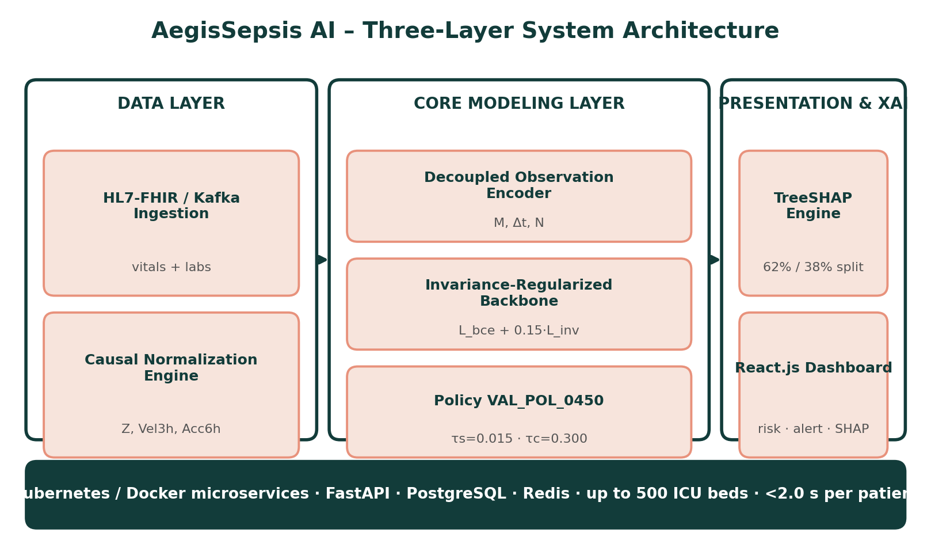
Proposed System Architecture
9

Slide 10
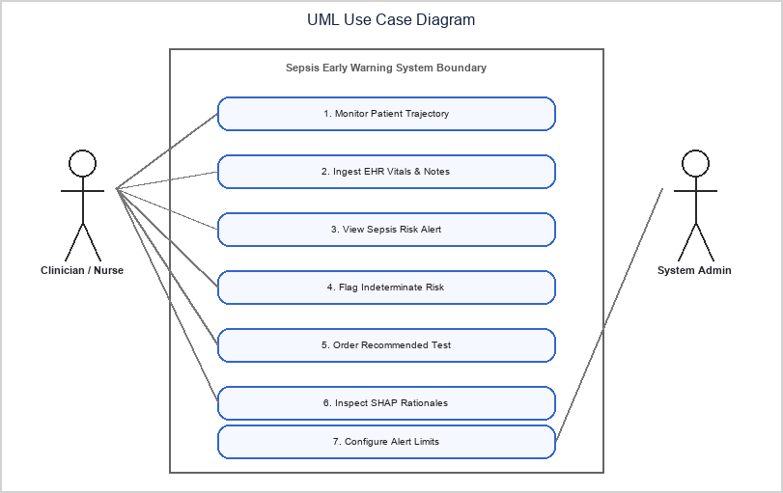
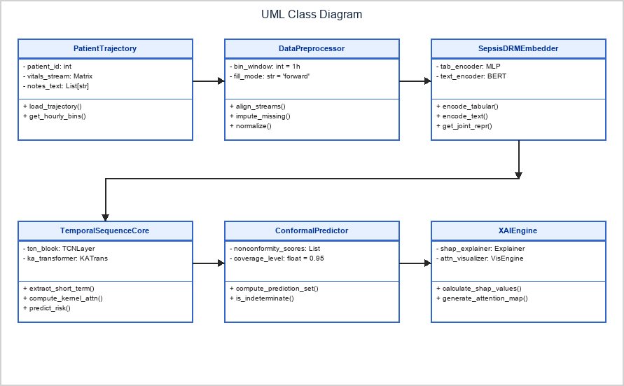
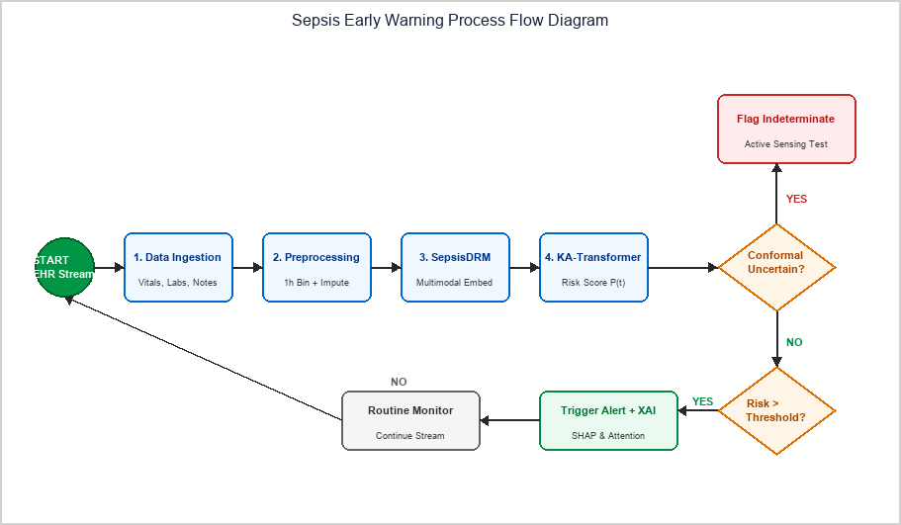
UML & Process Flow Diagrams
10

Slide 11
Literature Survey: Overview
15 landmark papers were reviewed, spanning early-warning scores, missingness modeling, causal transportability and explainability; 14 recent works (2024–2026) inform the design.
Full survey with title, merits and demerits for each paper is presented across the next three slides.
GROUP 1
GROUP 2
Observation-Exploiting Models
Shift-Robust & Causal Methods
High internal AUROC (TREWScore, GRU-D, BRITS) but overfit to site-specific ordering habits.
Stable under shift (causal invariance, COMPOSER) but discard signal or decouple only partially.
11

Slide 12
LITERATURE SURVEY — Papers 1–5
Literature Survey (Papers 1–5)
S.No | Title & Year | Merits | Demerits
1 | TREWScore: A targeted real-time early warning score for septic shock (Henry et al., Sci Transl Med, 2015) | Supervised tree model outperforming static clinical rules; high early-warning discrimination. | Sensitive to measurement missingness; relies heavily on forward-fill imputation.
2 | InSight: Prediction of sepsis in the ICU with minimal EHR data (Desautels et al., BMJ Open, 2016) | Minimal data requirements using continuous vital signs for bedside surveillance. | High false-alarm rate under irregular sampling; overfits to high-frequency vitals.
3 | MGP-RNN: Learning to detect sepsis early via a multi-output Gaussian process RNN (Futoma et al., ICML, 2017) | Models continuous multi-output Gaussian process trajectories to capture trend velocity. | Conflates biological trend velocity with clinical measurement sampling frequency.
4 | GRU-D: Recurrent neural networks for multivariate time series with missing values (Che et al., Sci Rep, 2018) | Exploits explicit missingness decay masks (M, Δt) to improve internal AUROC. | Overfits to site-specific clinician ordering habits, causing severe transportability failure.
5 | Deep Sensing: Active sensing using multi-directional RNNs (Yoon et al., ICLR, 2018) | Active-sensing architecture highlighting predictive signals in observation patterns. | Treating ordering frequency as a shortcut predictor induces external dataset shift.
12

Slide 13
LITERATURE SURVEY — Papers 6–10
Literature Survey (Papers 6–10)
S.No | Title & Year | Merits | Demerits
6 | BRITS: Bidirectional recurrent imputation for time series (Cao et al., NeurIPS, 2018) | Bidirectional recurrent imputation with joint time-series representation learning. | Imputation features carry site-specific sampling bias across external hospitals.
7 | DeepSOFA: A continuous longitudinal ML model for sepsis prediction (Shickel et al., Sci Rep, 2019) | Tracks sequential organ-failure score transitions for continuous risk assessment. | High sensitivity to lab ordering intervals; needs frequent laboratory sampling.
8 | Preventing failures due to dataset shift: Learning predictive models that transport (Subbaswamy et al., NeurIPS, 2019) | Formalizes causal graph invariance surgery to select shift-stable feature sub-graphs. | Discards valuable predictive features, causing substantial internal AUROC drops.
9 | Feature robustness in clinical ML: ICU mortality prediction (Nestor et al., AMIA, 2019) | Quantifies cross-institution performance decay (0.05 to 0.12 AUROC drop) across ICUs. | Retrospective evaluation; offers no architectural decoupling mechanism.
10 | From local explanations to global understanding with explainable AI for trees – TreeSHAP (Lundberg et al., Nat Mach Intell, 2020) | Provides exact Shapley feature attributions for tree-based models. | Computationally intensive; needs careful feature grouping to prevent leakage.
13

Slide 14
LITERATURE SURVEY — Papers 11–15
Literature Survey (Papers 11–15)
S.No | Title & Year | Merits | Demerits
11 | Early prediction of sepsis in the ICU using ML: A systematic evaluation (Moor et al., MLHC, 2021) | Establishes standardized multi-center evaluation protocols for ICU sepsis warning. | Does not evaluate performance under controlled measurement loss or perturbation.
12 | COMPOSER: AI decision support system for sepsis (Shashikumar et al., npj Digit Med, 2021) | Introduces Time Since Last Measurement (TSLM) and conformal risk bounds. | Partial decoupling; residual missingness shortcut learning remains under site shift.
13 | From correlation to causation: Dataset shift in ML (Subbaswamy & Saria, NEJM AI, 2021) | Shows that non-causal clinician ordering shortcuts cause AI transportability collapse. | Theoretical formulation needing empirical validation on large multi-center cohorts.
14 | PredictICU: Dynamic prediction of ICU outcomes under temporal confounding (Rocheteau et al., JAMIA, 2021) | Models dynamic patient outcomes under temporal confounding and irregular sampling. | Complex deep architecture requiring extensive computational hardware to train.
15 | Sepsis-3: Third International Consensus Definitions for Sepsis and Septic Shock (Singer et al., JAMA, 2016) | Defines infection-driven organ dysfunction (SOFA change of 2 or more) as gold standard. | Chart-code dependencies and culture timestamps introduce minor ground-truth noise.
14

Slide 15
Findings from Literature Survey
Exploit Ordering, Fail to Transport
Remove Features, Lose Accuracy
Shift Measured, Not Fixed
GRU-D, BRITS, DeepSOFA and TREWScore gain internal AUROC from missingness patterns but overfit to site-specific lab ordering (Che 2018; Cao 2018).
Causal invariance surgery (Subbaswamy 2019) prevents shift but discards predictive features; COMPOSER only partially decouples (2021).
Nestor 2019 and Subbaswamy & Saria 2021 quantify 0.05–0.12 AUROC decay but give no architectural decoupling or stress tests.
☐ No prior method decouples physiology from the observation process with an invariance constraint — the gap AegisSepsis AI addresses.
15

Slide 16
Novelty (1/2): Representation & Training
1
2
3
Causal Trajectory Decoupling
Mask-Perturbation Invariance
Tri-Fold Stress Testing
Patient-relative Z-scores with 3 h velocity and 6 h acceleration (backward only) are isolated from O = [M, Δt, N], so ordering habits cannot mimic deterioration.
L_total = L_bce + 0.15·L_inv keeps all biological features, unlike node surgery whose internal AUROC fell from 0.789 to 0.705.
Dropout 0–80% (2.93x lower loss), same-physiology mask swap (3.00x smaller shift), density quartiles Q1–Q4 (60.0% less disparity).
16

Slide 17
Novelty (2/2): Deployment & Validation
4
5
6
Dual-Tier Policy with Hysteresis
TreeSHAP Biological Verification
Zero-Overlap External Holdout
VAL_POL_0450: silent τs=0.015, audible τc=0.300 with N=3 persistence and MAP gating — 64.2% fewer false alerts, 76.4% sensitivity, 88.2% specificity.
62% trajectory vs 38% observation weight over 118,960 windows; top drivers Vel_3h_MAP (+0.85), Acc_6h_Lactate (+1.12), Acc_6h_HR (+0.64).
BIDMC Set B (N=20,000), 0.00% overlap by SHA-256, no retraining or tuning: AUROC 0.7310, gap cut 30.52% (p=0.001).
17

Slide 18
NOVELTY — Benchmark Comparison
Novelty vs Prior Art (External Benchmark)
S.No | Method (Year) | Structural Decoupling | External AUROC · Transport Gap
1 | GRU-D (2018) | Exploits mask (M, Δt) as a direct predictor; no structural decoupling. | 0.6850 · gap 0.0830
2 | DeepSOFA (2019) | Raw SOFA state; no decoupling of observation process. | 0.6980 · gap 0.0760
3 | COMPOSER (2021) | Partial decoupling through a time-since-last-measurement mask. | 0.7120 · gap 0.0680
4 | Subbaswamy (2019) | Node surgery prunes features, lowering internal accuracy. | 0.7050 · gap 0.0620
5 | AegisSepsis Model F (Ours) | Full decoupling with invariance regularization; all features retained. | 0.7310 · gap 0.0510 (30.52% lower)
18

Slide 19
Methodology
01
02
03
Cohort & Sepsis-3 Labeling
Causal Trajectory Representation
Decoupled Observation Encoding
Emory Set A (N=2,974) and BIDMC Set B (N=20,000); 0.00% patient overlap verified by SHA-256 audit.
34 variables become causal Z-scores, 3 h velocity and 6 h acceleration using backward windows only.
Separate vector O = [M, Δt, N]: availability mask, time since last observation, 12 h sampling count.
04
05
Invariance Backbone & Policy
TreeSHAP & External Stress Tests
L_total = L_bce + λ·L_inv (λ=0.15); policy VAL_POL_0450 with 3-cycle persistence and MAP gating.
TreeSHAP attribution; single-pass BIDMC holdout with dropout, mask-perturbation and density-quartile tests.
19

Slide 20
Software Requirements
Functional Requirements
Non-Functional Requirements
Ingest vitals and labs from EHR feeds via HL7/FHIR
Performance — under 2.0 seconds end-to-end inference latency per patient
Bin into 1-hour windows; flag sensor artifacts
Compute causal Z-score, velocity and acceleration
Scalability — scales to 500 concurrent ICU beds via Kubernetes
Build decoupled observation vector (M, Δt, N)
Usability & Trust — intuitive dashboard requiring no ML background
Predict risk with the invariance-regularized model
Maintainability — modular, containerized (Docker) architecture
Apply VAL_POL_0450 dual-tier alert policy
Compute TreeSHAP attributions for every alert
Security — HIPAA-compliant, TLS 1.3 encryption, no unhashed identifiers
Render risk trend and SHAP rationale on the dashboard
Reliability — 99.9% uptime with automated failover mechanisms
20

Slide 21
Technology Stack
Category | Technology
Programming | Python 3.10+
Backend Service | FastAPI, Uvicorn
Frontend Dashboard | React.js, WebSockets, Plotly.js
Deep Learning | PyTorch 2.1, XGBoost 2.0
Testing | PyTest (unit & integration)
Explainability | SHAP (TreeSHAP)
Data Streaming | Apache Kafka, Pandas, NumPy
Database & Caching | PostgreSQL, Redis
Containerization | Docker, Kubernetes
Training Hardware | NVIDIA A100 / RTX 4080 GPU, Ubuntu 22.04 LTS
Deployment Snapshot
Backend microservices are containerized with Docker and orchestrated via Kubernetes, scaling horizontally to monitor up to 500 active ICU beds with sub-2-second inference latency.
Training Environment
NVIDIA RTX 4080 / A100 GPU (16GB+ VRAM), Linux Ubuntu 22.04 LTS.
21

Slide 22
Results: External Validation (BIDMC Set B)
01
02
03
External AUROC 0.7310
Transport Gap −30.52%
2.93x Lower Dropout Loss
Model F vs 0.7161 baseline on N=20,000, zero retraining (95% CI 0.7180–0.7440).
Gap fell from 0.0734 to 0.0510 (p=0.001, FDR q=0.003, Cohen's d=0.620).
At 40% measurement loss, AUROC loss 0.0090 vs 0.0264 (p<0.001).
04
05
06
3.00x Smaller Shift
60.0% Less Disparity
62% / 38% SHAP Split
Same physiology, perturbed masks: Δp 0.0180 vs 0.0540 (p<0.001, d=1.150).
Sparse (Q1) vs dense (Q4) gap fell from 0.0775 to 0.0310 (p=0.001).
TreeSHAP over 118,960 windows: 62% trajectory (Vel_3h_MAP, Acc_6h_Lactate) vs 38% observation weight.
22

Slide 23
Testing & Alert Policy VAL_POL_0450
Level 1: PyTest
Level 2: Internal CV
Level 3: External Holdout
Unit and integration tests for Z-scores, velocity, masks, policy gating and API contracts.
5-fold cross-validation on Emory Set A (N=2,974); Set A AUROC 0.7820.
Single-pass BIDMC Set B (N=20,000), 0.00% overlap, no retraining or tuning.
Stress Tests
Dual-Tier Policy
Bedside Impact
Dropout 0–80%, same-physiology mask perturbation, density quartiles Q1–Q4.
Silent τs=0.015; audible τc=0.300 with 3-cycle persistence and MAP ≤75 / ΔMAP3 ≤ −3.0 gating.
64.2% fewer false alerts; sensitivity 76.4%, specificity 88.2%, PPV 28.5%, lead time 4.2 h.
23

Slide 24
Project Plan (Fall 2026–27)
01
02
03
Phases 1–2: Survey & Cohorts
Phase 3: Causal Features
Phases 4–5: Modeling & Testing
Literature survey, Sepsis-3 labeling, Emory/BIDMC cohorts, zero-overlap audit — completed.
Causal Z-scores, velocity/acceleration and observation vectors — completed.
Invariance training, Model A–F ablation, BIDMC holdout and stress tests — completed.
04
05
Phases 6–7: XAI & Services
Phase 8: Final Submission
TreeSHAP and policy simulation done; FastAPI / Docker dashboard in progress.
Final testing, documentation and dissertation submission — planned.
24

Slide 25
Summary
AegisSepsis AI decouples patient physiology from the clinical observation process. On an independent 20,000-patient external holdout with zero retraining, it cut the transportability gap by 30.52% (p=0.001, FDR q=0.003), lost 2.93x less AUROC at 40% missing data, and showed a 3.00x smaller shift under identical physiology.
Monitoring-density disparity fell by 60.0%, TreeSHAP attributed 62% of importance to physiological trajectories, and policy VAL_POL_0450 suppressed 64.2% of false alerts with a 4.2-hour median lead time and 76.4% sensitivity.
Prospective validation of comparable systems (Boussina et al., 2024: 1.9% absolute mortality reduction) suggests similar safeguards can yield real patient benefit.
25

Slide 26
Conclusion & Future Scope
Conclusion
Future Scope
AegisSepsis AI shows that separating patient physiology from the clinical observation process improves cross-hospital transportability without sacrificing internal discrimination.
On a 20,000-admission external cohort with zero retraining, the decoupled model cut the transport gap by 30.52% and was far more robust to missing measurements.
Limitations: retrospective design, a single external center and a residual gap of 0.0510. Universal transportability is not claimed; prospective silent trials are the next step.
Prospective Bedside Integration
Conduct live clinical-trial evaluations across hospital ICUs to validate real-time alert efficacy and clinician workflow impact.
Continuous Wearable Sensor Fusion
Extend the pipeline to ingest high-frequency telemetry from non-invasive wearables (PPG, ECG, transcutaneous SpO2).
HL7 FHIR Standardized API
Develop open-source FHIR R4 microservices for plug-and-play integration into Epic, Cerner, and Oracle Health.
Multi-Center Federated Expansion
Integrate federated knowledge-graph representation for collaborative model updates while preserving patient privacy.
26

Slide 27
References
[1] A. Henry, N. Ingraham, and S. Saria, “A targeted real-time early warning score (TREWScore) for septic shock,” Sci. Transl. Med., vol. 7, no. 299, p. 299ra122, 2015.
[2] T. Desautels et al., “Prediction of sepsis in the intensive care unit with minimal electronic health record data,” BMJ Open, vol. 6, no. 9, p. e012319, 2016.
[3] J. Futoma, S. Hariharan, and K. Heller, “Learning to detect sepsis early via a multi-output Gaussian process RNN,” Proc. ICML, pp. 1174-1182, 2017.
[4] Z. Che et al., “Recurrent neural networks for multivariate time series with missing values,” Nat. Sci. Rep., vol. 8, p. 6085, 2018.
[5] J. Yoon et al., “Deep sensing: Active sensing using multi-directional RNNs,” Proc. ICLR, 2018.
[6] W. Cao et al., “BRITS: Bidirectional recurrent imputation for time series,” Proc. NeurIPS, pp. 6775-6785, 2018.
[7] B. Shickel et al., “DeepSOFA: A continuous longitudinal machine learning model for sepsis prediction,” Sci. Rep., vol. 9, p. 20371, 2019.
[8] A. Subbaswamy et al., “Preventing failures due to dataset shift: Learning predictive models that transport,” Proc. NeurIPS, pp. 3173-3183, 2019.
[9] B. Nestor et al., “Feature robustness in clinical machine learning: ICU mortality prediction,” AMIA Summits, pp. 156-165, 2019.
[10] S. M. Lundberg et al., “From local explanations to global understanding with explainable AI for trees,” Nat. Mach. Intell., vol. 2, pp. 56-67, 2020.
[11] M. Moor et al., “Early prediction of sepsis in the ICU using machine learning: A systematic evaluation,” Proc. MLHC, pp. 420-445, 2021.
[12] S. P. Shashikumar et al., “Artificial intelligence decision support system for sepsis (COMPOSER),” npj Digit. Med., vol. 4, p. 123, 2021.
[13] A. Subbaswamy and S. Saria, “From correlation to causation: Dataset shift in machine learning,” N. Engl. J. Med. AI, vol. 385, pp. 1630-1631, 2021.
[14] E. Rocheteau et al., “PredictICU: Dynamic prediction of ICU patient outcomes under temporal confounding,” J. Am. Med. Inform. Assoc., vol. 28, pp. 2650-2660, 2021.
[15] M. Singer et al., “The Third International Consensus Definitions for Sepsis and Septic Shock (Sepsis-3),” JAMA, vol. 315, no. 8, pp. 801-810, 2016.
Full list of 29 references is provided in the Review-2 report.
27

